Slide 1



Disciplined Agile Delivery: The Foundation for Scaling Agile/Scrum
Scott W. Ambler Senior Consulting Partner
scott [at] scottambler.com
@scottwambler
Disciplined Agile Delivery

Slide 2

Feel free to ask questions at any time

Slide 3
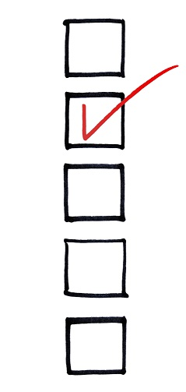
Agenda
Disciplined Agile Delivery (DAD)
A Disciplined Agile Manifesto
Foundations of DAD
The DAD Lifecycle
Goal Driven, Not Prescriptive
DAD Roles and Teams
Scaling DAD
What it Means to Scale
Scaling Agile in Practice
Agile Practices that Support Scaling
Parting Thoughts

Slide 4

Part 1 Disciplined Agile Delivery (DAD)

Slide 5
Exercise: What Are You Doing on Agile Projects?
Organize into teams of 5-8 people
Take a few minutes to introduce yourselves to one another
For 10 minutes, discuss within the team:
What agile projects have you been on?
What was different compared with non-agile ones?
What was the same?
What types of activities you do to initiate the project and how long did it take? (e.g. Did you do any initial modeling or planning? Did you need to get provide estimates go get funding? Other activities?)
What activities did you do during construction? (e.g. How did you approach documentation? Planning? Testing?)
What did you need to do to deploy/release your solution into production? How long did it take?
Someone needs to be a spokesperson for your team
A spokesperson will share a few key learnings with the larger group

Slide 6
The Agile Manifesto
We value:
Individuals and interactions over processes and tools
Working software over comprehensive documentation
Customer collaboration over contract negotiation
Responding to change over following a plan
That is, while there is value in the items on the right, we value the items on the left more.
Source: www.agilemanifesto.org
Notes:
This manifesto is the work of the organization created as the “Agile Alliance”.
The Agile Manifesto is a set of principles put forth by a group of software development thought leaders that were frustrated with past project failures resulting from overly structured and bureaucratic processes.
The Manifesto was drafted in 2001 by the following individuals:
Kent Beck Mike Beedle Arie van Bennekum Alistair Cockburn Ward Cunningham Martin Fowler James Grenning Jim Highsmith Andrew Hunt Ron Jeffries Jon Kern Brian Marick Robert C. Martin Steve Mellor Ken Schwaber Jeff Sutherland Dave Thomas

Slide 7

But… DAD Extends Agile Thinking
Solutions, not just software
Stakeholders, not just customers
The organizational ecosystem, not just development teams
Notes:
These enhancements reflect the realities faced by most Disciplined Agile Delivery (DAD) teams.
The changes that DAD suggests for the Agile Manifesto are straightforward:
Where the original manifesto focused on software development, a term that too many people have understood to mean only software development, we suggest that it should instead focus on solution delivery.
Where the original manifesto focused on customers, a word that for too many people appears to imply only the business stakeholders, we suggest that it focus on the full range of stakeholders instead.
Where the original manifesto focused on development teams, we suggest that the over- all organizational ecosystem and its improvement be taken into consideration.

Slide 8
So… A Disciplined Agile Manifesto?
We value:
Individuals and interactions over processes and tools
Working solutions over comprehensive documentation
Stakeholder collaboration over contract negotiation
Responding to change over following a plan
That is, while there is value in the items on the right, we value the items on the left more.
Notes:
This manifesto is the work of the organization created as the “Agile Alliance”.
The Agile Manifesto is a set of principles put forth by a group of software development thought leaders that were frustrated with past project failures resulting from overly structured and bureaucratic processes.
The Manifesto was drafted in 2001 by the following individuals:
Kent Beck Mike Beedle Arie van Bennekum Alistair Cockburn Ward Cunningham Martin Fowler James Grenning Jim Highsmith Andrew Hunt Ron Jeffries Jon Kern Brian Marick Robert C. Martin Steve Mellor Ken Schwaber Jeff Sutherland Dave Thomas

Slide 9
DAD Principles – Extending the Twelve Principles of Agile Software (www.agilealliance.org)
Our highest priority is to satisfy the stakeholder through early and continuous delivery of valuable solutions.
Welcome changing requirements, even late in the solution delivery lifecycle. Agile processes harness change for the customer's competitive advantage.
Deliver working solutions frequently, from a couple of weeks to a couple of months, with a preference to the shorter time scale.
Stakeholders and developers must work together daily throughout the project.
Build projects around motivated individuals. Give them the environment and support they need, and trust them to get the job done.
The most efficient and effective method of conveying information to and within a delivery team is face-to-face conversation.
Quantified business value is the primary measure of progress.
Agile processes promote sustainable delivery. The sponsors, developers, and users should be able to maintain a constant pace indefinitely.

Slide 10
DAD Principles – Extending the Twelve Principles of Agile Software (www.agilealliance.org) cont.
Continuous attention to technical excellence and good design enhances agility.
Simplicity – the art of maximizing the amount of work not done – is essential.
The best architectures, requirements, and designs emerge from self-organizing teams.
At regular intervals, the team reflects on how to become more effective, then tunes and adjusts its behavior accordingly.
Leverage and evolve the assets within your organizational ecosystem, and collaborate with the people responsible for those assets to do so.
Visualize workflow to help achieve a smooth flow of delivery while keeping work in progress to a minimum.
The organizational ecosystem must evolve to reflect and enhance the efforts of agile teams, yet be sufficiently flexible to still support non-agile or hybrid teams

Slide 11
Exercise: Questioning Agile Claims
Get back into your teams
Choose three interesting claims from the following list
For 10 minutes discuss the three claims as a group
How true is each claim?
Is anything being glossed over?
Reword each claim as “Existing claim although XYZ” – For example, “Development professionals know what to do” becomes “Development professionals know what to do although they aren’t process experts and may not know all options available to them”
Claims:
Requirements evolve throughout the lifecycle
Simple designs are best
Teams should be self-organizing
Delivery teams don’t need prescriptive process definitions
Development professionals should validate their own work to the best of their ability
Disciplined agile teams work in an iterative manner
A spokesperson should be prepared to share a few key learnings with the larger group

Slide 12
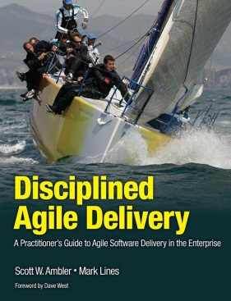
Disciplined Agile Delivery (DAD)
Disciplined Agile Delivery (DAD) is a process decision framework
The key characteristics of DAD:
People-first
Goal-driven
Hybrid agile
Learning-oriented
Full delivery lifecycle
Solution focused
Risk-value lifecycle
Enterprise aware
Notes:
From this definition, you can see that the DAD process framework has several important characteristics. These characteristics are:
People first
Learning oriented
Agile
Hybrid
IT solution focused
Goal-driven
Delivery focused
Risk and value driven
Enterprise aware

Slide 13
DAD is a Hybrid Framework
Crystal
…and more
Agile Practices
“Traditional”
Agile Data
Unified Process
Agile Modeling
Scrum
Kanban
Lean
DAD leverages proven strategies from several sources,
providing a decision framework to guide your adoption and
tailoring of them in a context-driven manner.

Slide 14
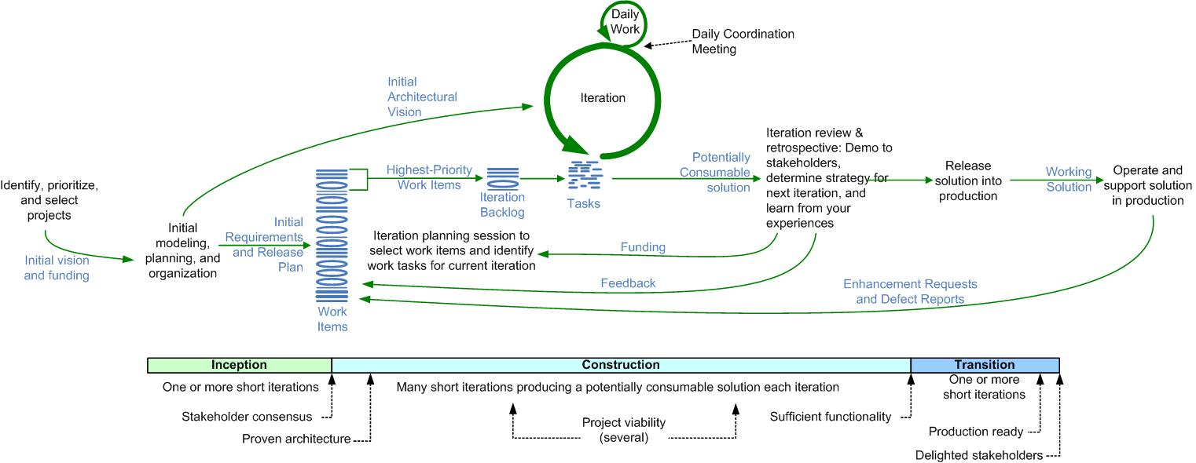
The Basic/Agile Lifecycle of Disciplined Agile Delivery (DAD)

Slide 15
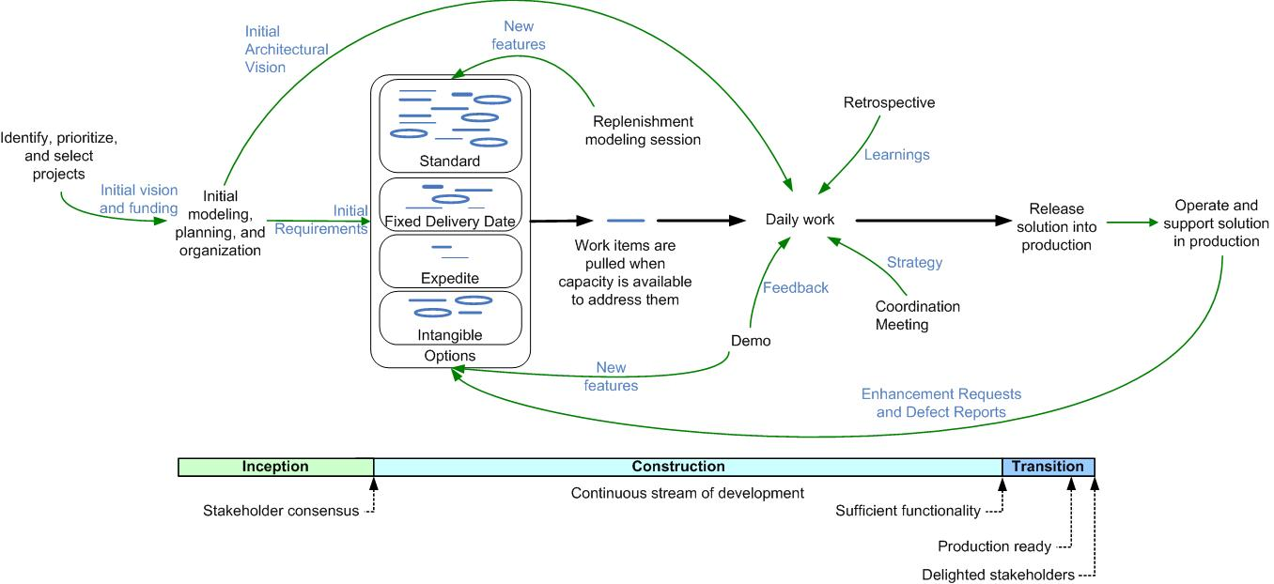
DAD Lifecycle: Advanced/Lean

Slide 16
The Phases Disappear Over Time
First release:
Inception
Construction
Transition
Second release:
I
Construction
T
Third release:
I
Construction
T
.
.
.
N^{th}+ releases:
C
T
C
T
C
T
C
T

Slide 17
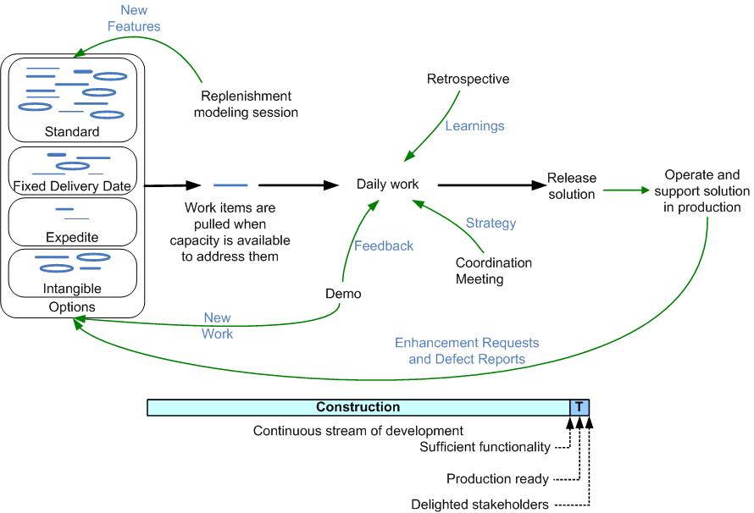
DAD Lifecycle: Continuous Delivery

Slide 18
Exercise: Enterprise Awareness
Get back into your teams
For 10 minutes, discuss:
What other teams might an agile team need to interact with in your organization?
Do these teams work in an agile manner? If not, what are you doing to address this?
What information do your agile teams need to provide to senior management for governance purposes? Why?
Are your agile teams expected to conform to an existing technical architecture? Organizational business vision? If so, how is this supported?
Do you have coding guidelines to follow? Data guidelines? Usability? Security? Other? How are they supported or enforced?
If you were CEO for a day, what would you do to address these issues more effectively?
A spokesperson should be prepared to share a few key learnings with the larger group

Slide 19
Agile Experiences with Enterprise Awareness
Have your (un)successful agile project teams worked with any of the following teams within the organization? (Please check all that apply)
Source: 2012 Agile Scaling Survey
www.ambysoft.com/surveys/
Notes:
Enterprise awareness is an important aspect of self discipline because as a professional you should strive to do what’s right for your organization and not just what’s interesting for you. Teams developing in isolation may choose to build something from scratch, or use different development tools, or create different data sources, when perfectly good ones that have been successfully installed, tested, configured, and fine-tuned already exist within the organization. We can and should do better by doing the following:
Leveraging enterprise assets. There may be many enterprise assets, or at least there should be, which you can use and evolve. These include common development guidelines, such as coding standards, data conventions, security guidelines, and user interface standards. DAD teams strive to work to a common infrastructure; for example, they use the enterprise-approved technologies and data sources whenever possible, and better yet they work to the “to be” vision for your infrastructure. But enterprise assets are far more than standards. If your organization uses a disciplined architecture-centric approach to building enterprise software, there will be a growing library of service-based components to reuse and improve upon for the benefit of all current and future solutions. To do this DAD teams will collaborate with enterprise professionals – including enterprise architects, enterprise business modelers, data administrators, operations staff, and reuse engineers – throughout the lifecycle and particularly during Inception during envisioning efforts. Leveraging enterprise assets increases consistency and thereby ease of maintenance, decreases development costs and time, and decreases operational costs.
Enhancing your organizational ecosystem. The solution being delivered by a DAD team should minimally fit into the existing organizational ecosystem – the business processes and systems supporting them – it should better yet enhance that ecosystem. To do this, the first step is to leverage existing enterprise assets wherever possible as described earlier. DAD teams will work with operations and support staff closely throughout the lifecycle, particularly the closer you get to releasing into production, to ensure that they understand the current state and direction of the organizational ecosystem. DAD teams will often be supported by an additional independent test team which will perform production integration testing (amongst other things) to ensure that your solution works within the target production environment which it will face at deployment time.
Sharing learnings. DAD teams are learning oriented, and one way to learn is to hear about the experiences of others. The implication is that DAD teams must also be prepared to share their own learnings with other teams. Within IBM we support agile discussion forums, informal presentations, training sessions delivered by senior team members, and internal conferences to name a few strategies.
Open and honest monitoring. Although agile approaches are based on trust, smart governance strategies are based on a “trust but verify and then guide” mindset. An important aspect of appropriate governance is the monitoring of project teams through various means. One strategy is for anyone interested in the current status of a DAD project team to attend their daily coordination meeting and listen in, a strategy promoted by the Scrum community. Although it’s a great strategy we highly recommend, it unfortunately doesn’t scale very well because the senior managers responsible for governance are often busy people with many efforts to govern, not just your team. In fact Scott found exactly this in the 2010 How Agile Are You? survey. Another approach, one which we’ve seen to be incredibly effective, is for DAD teams to use instrumented and integrated tooling, such as Rational Team Concert (RTC), which generates metrics in real time that can be displayed on project dashboards. You can see an example of such a dashboard for the Jazz team itself at www.jazz.net, a team following an open commercial strategy. Such dashboards are incredibly useful for team members to know what is going on, let alone senior managers. A third strategy is to follow a risk-driven lifecycle, discussed in the next section, with explicit milestones which provide consistent and coherent feedback as to the project status to interested parties.
See Disciplined Agile Delivery (IBM Press 2012) for a detailed discussion of the importance of enterprise awareness. http://www.ambysoft.com/books/dad.html

Slide 20
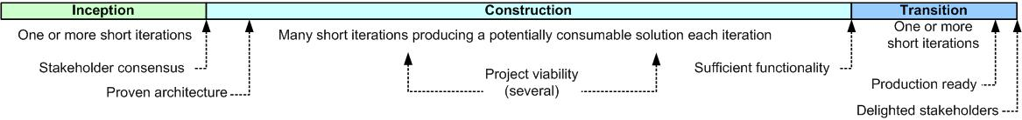
Governance is Built Into DAD
Governance strategies built into DAD:
Risk-value lifecycle
Light-weight milestone reviews
“Standard” opportunities for increased visibility and to steer the team provided by agile
Enterprise awareness
Robust stakeholder definition
Development intelligence via automated dashboards

Slide 21
Scrum Roles
Scrum
Master
Product
Owner
Team
Member
Notes:
Team Lead: Agile process expert, keeps team focused on achievement of goals, removes impediments
Product Owner : Owns the product vision, scope and priorities of the solution
Architecture Owner: Owns the architecture decisions and technical priorities, mitigates key technical risks
Team Member: Cross-functional team members that deliver the solution
Stakeholder: Includes the customer but also other stakeholders such as Project Sponsor, operations, architecture, database groups, governance bodies

Slide 22
Disciplined Agile Delivery (DAD) Roles
Primary
Roles
Team Lead
Product
Owner
Team
Member
Stakeholder
Architecture
Owner
Secondary
Roles
(for scaling)
Independent
Tester
Specialist
Domain
Expert
Technical
Expert
Integrator
Notes:
Team Lead: Agile process expert, keeps team focused on achievement of goals, removes impediments
Product Owner : Owns the product vision, scope and priorities of the solution
Architecture Owner: Owns the architecture decisions and technical priorities, mitigates key technical risks
Team Member: Cross-functional team members that deliver the solution
Stakeholder: Includes the customer but also other stakeholders such as Project Sponsor, operations, architecture, database groups, governance bodies

Slide 23
Exercise: Transitioning to DAD Roles
Get back into your teams
Choose two of the following “traditional” roles:
Business analyst
Project manager
QA professional
Database administrator
Tester
For five minutes, discuss:
Of the DAD roles previously described, which one(s) are the most likely ones for a person in each role to move to?
What strengths do they bring to that role?
What challenges will they face?
A spokesperson should be prepared to share a few key learnings with the larger group

Slide 24

Forming DAD Teams
Effective teams follow the 4th and 5th principles of the Agile Manifesto:
Stakeholders and developers must work together daily throughout the project
Build projects around motivated individuals. Give them the environment and support they need, and trust them to get the job done

Slide 25
Strategies for Effective Teams
Effective teams:
Are focused
Are tailored to the environment
Are based on trust and respect
Are safe
Provide learning opportunities
Are as small as possible
Have shared workspaces
Are “whole”
Are self-organizing within the constraints of the organization
Have adequate resources to fulfill their remit
Are accountable
Are self-aware
Are enterprise aware
Include dedicated people
Are geographically close
Follow a common strategy
Stay together

Slide 26
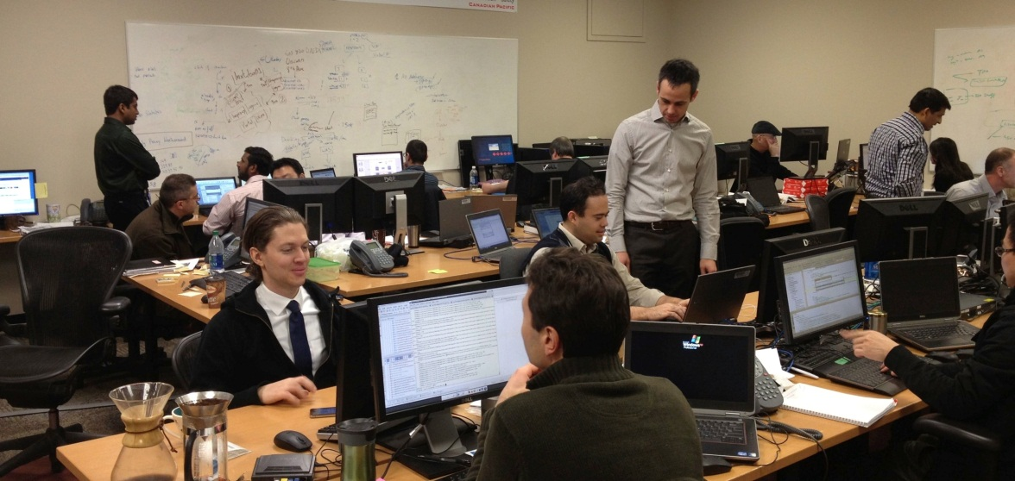
Whole Teams
Team members are cross-functional “generalizing specialists”
Better able to collaborate with others and do the work that needs to be done at any point in time
Team works together to deliver the work that they have committed to deliver to the product and architecture owners at the beginning of each iteration

Slide 27
Exercise: Agile teaming challenges
Get back into your teams
Take 10 minutes to discuss within the team:
What challenges does your organization face when forming agile teams?
What experiences have you had with forming small, medium, and large project teams? How did things differ?
What experiences have you had organizing project teams with different levels of geographic distribution? Everyone in the same work room? Everyone on same floor? Same building? Same city? Same country? Global?
A spokesperson should be prepared to share a few key learnings with the larger group

Slide 28
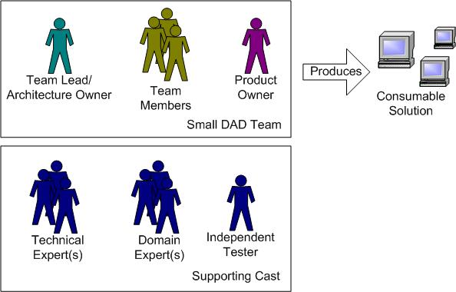
Small Teams (2 to 15 People)

Slide 29
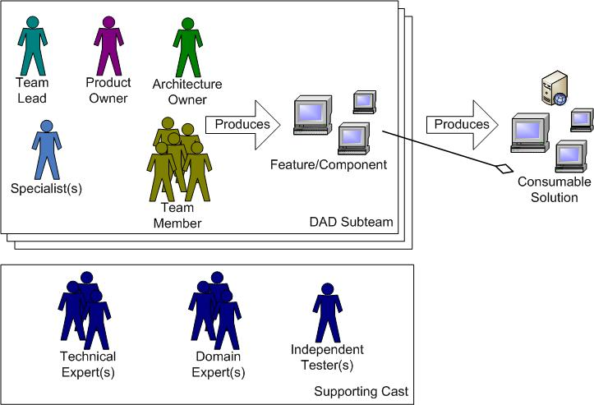
Medium-Sized Teams (10 to 40 people)
Notes:
Strategies for medium-sized teams
Increased envisioning and release planning efforts during Inception
Daily subteam and team coordination meetings
Lean daily coordination meetings
Electronic tooling

Slide 30
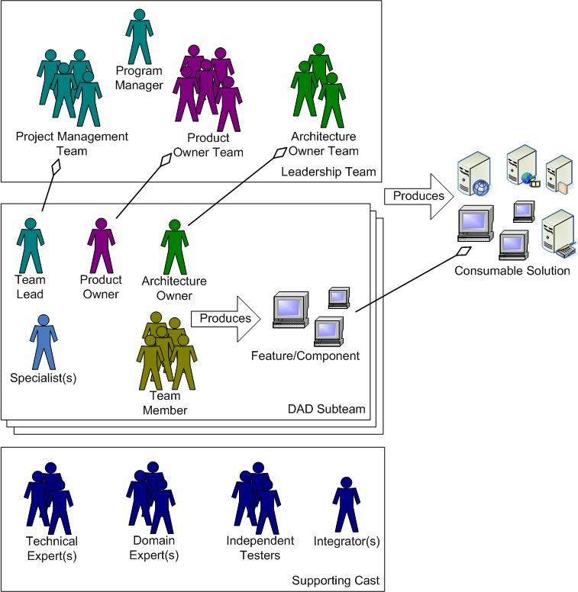
Large Teams (30 or More People)
Organizational options:
Feature teams: A subteam works on a feature from end to end.
Component teams: A subteam does all the work for a specific component.
Internal open source: A component is developed via open source techniques.
Notes:
Large teams require more coordination in these areas
Project management coordination
Requirements coordination
Technical coordination

Slide 31
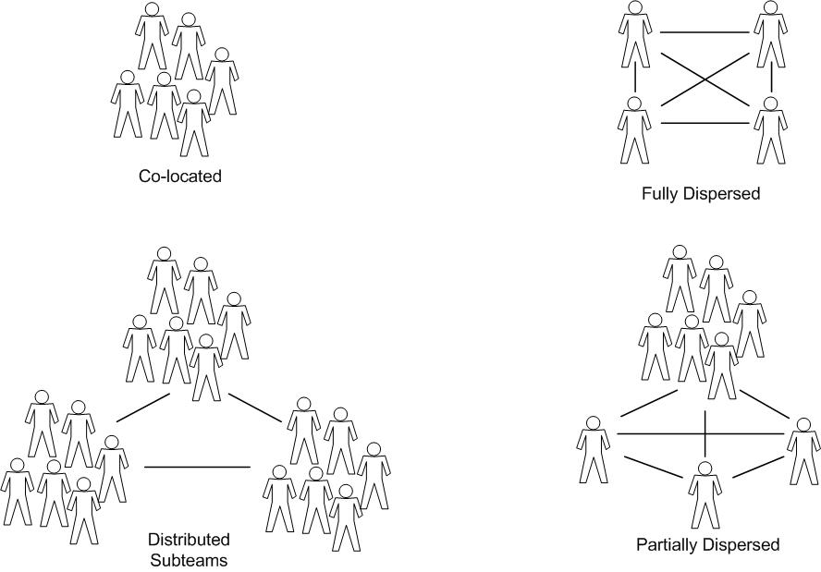
Geographically Distributed/Dispersed Teams

Slide 32
Potential Challenges When Building Teams
You don’t have adequate agile mentoring
You don’t have team leads that are skilled coaches
You don’t have (enough) generalizing specialists
You don’t have skilled product owners
Your human resources (HR) department is geared toward staffing traditional teams
You don’t have (enough) agile-experienced people
You can’t build a whole team
Not everyone is an agile expert
You don’t know how to identify agile-experienced people
Some of your staff want/need to be directed and not be self-organizing

Slide 33
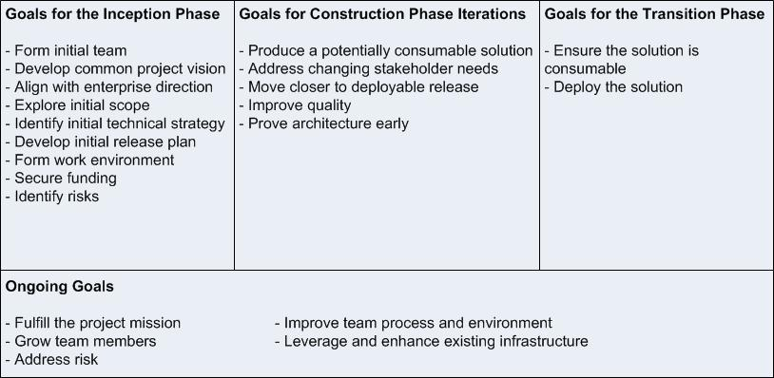
DAD is Goal-Driven, Not Prescriptive
Notes:
There are various goals that a team needs to address throughout the lifecycle
For each goal there are several issues to consider
For each issue there are different techniques to address it
Each technique has its advantages and disadvantages
Your choices depend on the context of the situation faced by a team

Slide 34
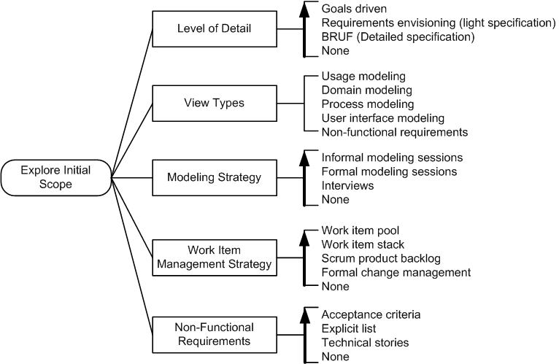
Goal: Explore the Initial Scope

Slide 35
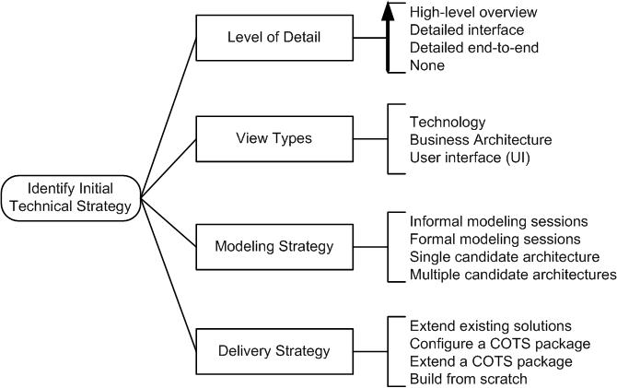
Goal: Identify Initial Technical Strategy

Slide 36
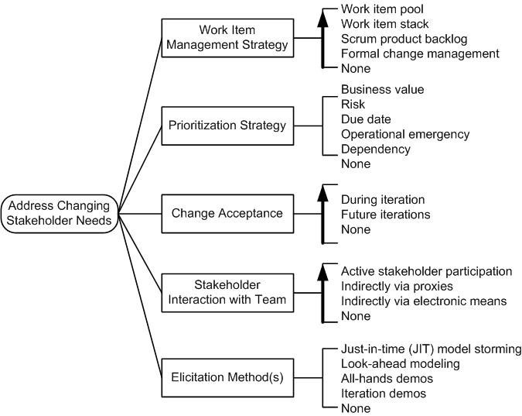
Goal: Address Changing Stakeholder Needs

Slide 37
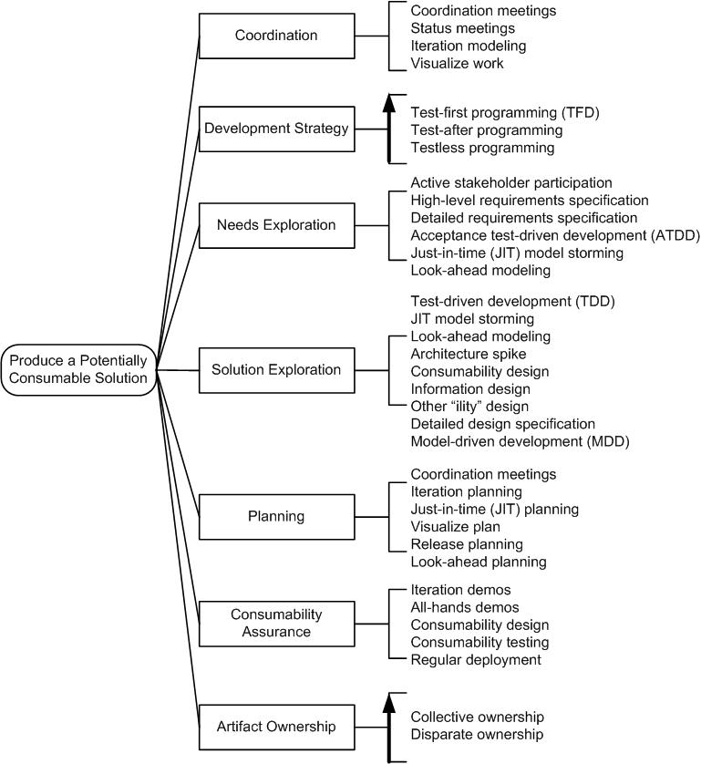
Goal: Produce a Potentially Consumable Solution

Slide 38
Exercise: Tailoring Factors
Get back into your smaller teams
Take 10 minutes to discuss within the team:
Considering the goal diagrams on the previous slide, what factors would you decide how to tailor your approach?
Where possible, discuss actual agile projects and compare the differences in situations that you faced
A spokesperson will share a few key learnings with the larger group

Slide 39
Part 2 Scaling DAD

Slide 40
Scaling/Tailoring Complexity Factors
Domain Complexity
motivates
Straightforward
Geographic
Distribution
Team
Size
Very complex
motivates
Co-located
motivates
Technical Complexity
2
Global
1000s
Straightforward
motivates
varies by
motivates
Very complex
Organizational
Distribution
Team
Culture
Compliance
affects
Single
varies by
Agile
None
Outsourcing
Rigid
affects
Life critical
affects
Organizational
Culture
Agile
Rigid
Notes:
How a team chooses to tailor DAD to address the goals will depend on several factors:
Geographical distribution
Team size
Regulatory compliance (internal and external)
Domain complexity
Technical complexity
Organizational distribution
Team culture
Organizational culture

Slide 41
Exercise: Exploring the Initial Scope
Get back into your smaller teams
Goal:
In 10 min create a project profile focused on exploring the initial scope
Instructions:
Identify the team member(s) who have been involved with an agile team where some initial requirements elicitation occurred. If there are several, quickly discuss each project and choose the one most interesting to you
Describe how the team approached initial requirements elicitation – How much effort was it? What artifacts were created? Who was involved? How was the output used by the team? How were the requirements validated?
Describe the project, considering the complexity factors described previously
What are the advantages and disadvantages of what the team did? Think short term and long term.
A spokesperson will share a few key learnings with the larger group

Slide 42
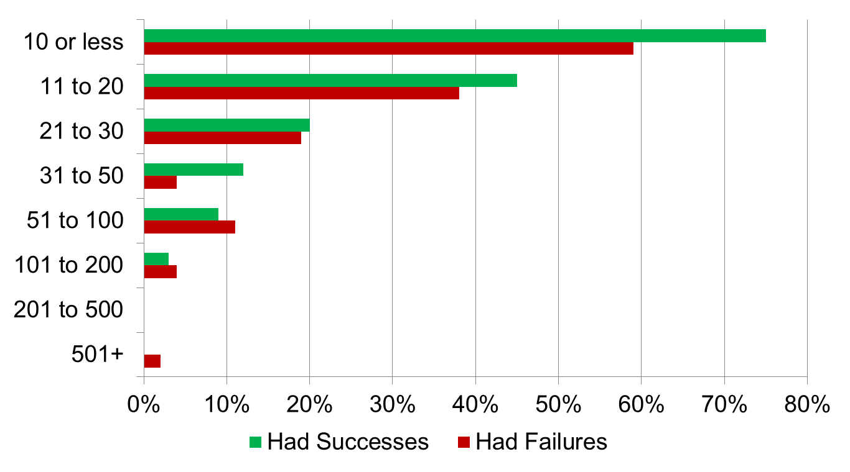
Agile Experiences with Team Size
On your (un)successful agile projects, how many IT team members were there?
Source: 2012 Agile Scaling Survey
www.ambysoft.com/surveys/
Notes:
Original source data, questions, and a slide deck are available free of charge at www.ambysoft.com/surveys/

Slide 43
Large Teams
Organizational options:
Feature teams: A subteam works on a feature from end to end.
Component teams: A subteam does all the work for a specific component.
Internal open source: A component is developed via open source techniques.
Notes:
Large teams require more coordination in these areas
Project management coordination
Requirements coordination
Technical coordination

Slide 44
Exercise: Large Team Organization
Get back into your smaller teams
Instructions:
Take 10 minutes to discuss the feature team, component team, and internal open source organizational strategies
What are the advantages and disadvantages of each?
What do you need to do to make each strategy work? During Inception, Construction, and Transition?
How would each strategy affect the goals of Identify an Initial Technical Strategy and Produce a Potentially Consumable Solution
A spokesperson will share a few key learnings with the larger group

Slide 45
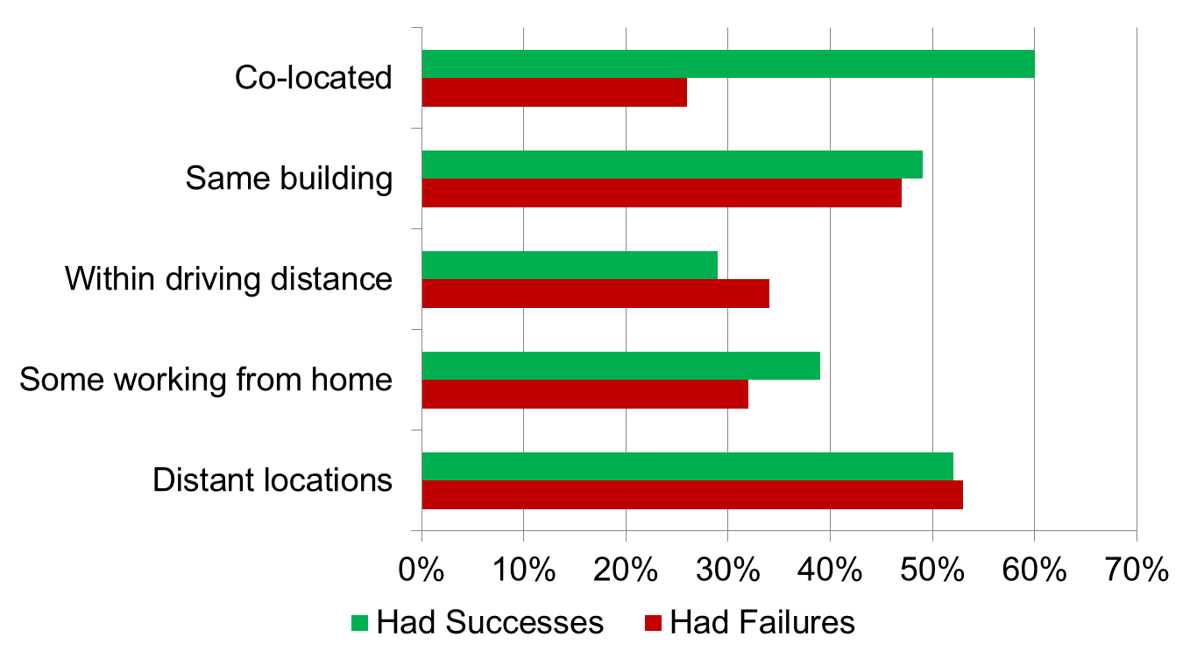
Agile Experiences with Geographic Distribution
On your (un)successful agile projects, how distributed were team members?
Source: 2012 Agile Scaling Survey
www.ambysoft.com/surveys/
Notes:
Original source data, questions, and a slide deck are available free of charge at www.ambysoft.com/surveys/

Slide 46
Geographically Distributed/Dispersed Teams

Slide 47
Exercise: Geographically Distributed Teams
Get back into your smaller teams
Instructions:
Take 10 minutes to discuss the implications of the team distribution strategies
What are the advantages and disadvantages of each?
What do you need to do to make each strategy work? During Inception, Construction, and Transition?
How would each strategy affect the goals of Identify an Initial Technical Strategy and Produce a Potentially Consumable Solution
A spokesperson will share a few key learnings with the larger group

Slide 48
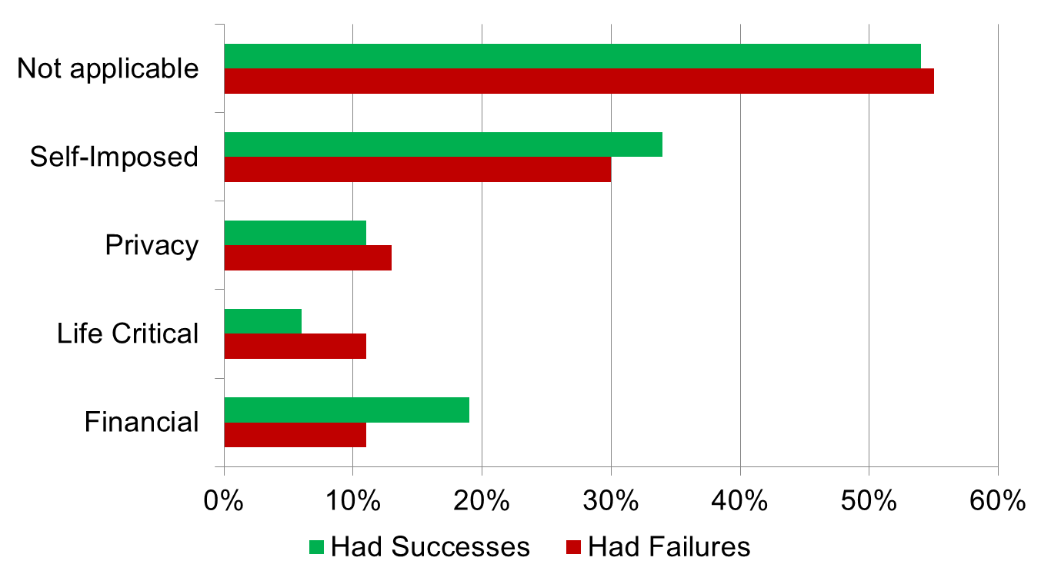
Agile Experiences with Compliance
On your (un)successful agile projects, was compliance applicable?
Note: Self imposed = CMMI, ISO, …
Source: 2012 Agile Scaling Survey
www.ambysoft.com/surveys/
Notes:
Original source data, questions, and a slide deck are available free of charge at www.ambysoft.com/surveys/

Slide 49
Agile Experiences with Domain Complexity
Question: From the point of view of the problem/business domain, at what level(s) of complexity has the organization (un)successfully applied agile techniques? (Please check all that apply)
Source: 2012 Agile Scaling Survey
www.ambysoft.com/surveys/

Slide 50
Agile Experiences with Technical Complexity
Question: In which technical situations has the organization (un)successfully applied agile approaches? (Please check all that apply)
Source: 2012 Agile Scaling Survey
www.ambysoft.com/surveys/

Slide 51
Agile Experiences with Organizational Distribution
Question: In which of the following situations has the organization (un)successfully applied agile techniques? (Please check all that apply)
Source: 2012 Agile Scaling Survey
www.ambysoft.com/surveys/

Slide 52
“Common” Agile Practices that Support Scaling
Continuous Coordination
Coordination meetings – e.g. “Daily stand ups”
Development intelligence
Demos
Short iterations/sprints
Regularly producing a potentially consumable solution – e.g. Potentially shippable software in Scrum
Continuous integration
Better yet continuous deployment
Agile planning
Initial high-level release planning
Just in time (JIT) detailed planning – e.g. Iteration/sprint planning
Look-ahead planning

Slide 53
Some “Additional” Practices for Scaling Agile
Agile Modeling (and Documentation)
API First
Continuous Deployment
Parallel Independent Testing
Leadership Teams
Multiple Backlog Management

Slide 54

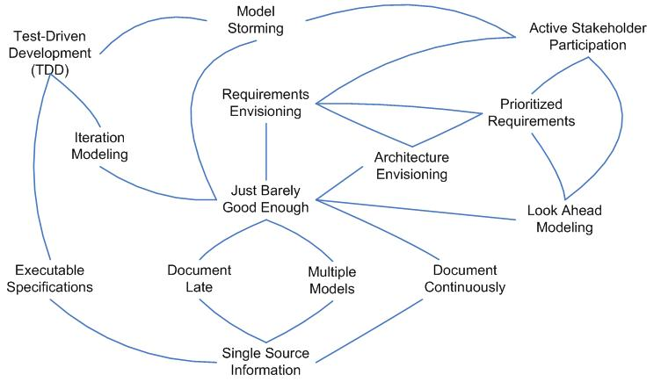
Agile Modeling’s Best Practices
Notes:
www.agilemodeling.com/essays/bestPractices.htm
This is a “practices map”, showing several practices and relationships between them.

Slide 55
Some Industry Stats
2009 Agile Project Initiation Survey:
89% of agile teams do some sort of up-front requirements modeling
86% of agile teams do some sort of up-front architecture modeling
56% create a project vision/chart document
2008 Test-Driven Development Survey
When it came to requirements capture, 85% of respondents wrote some documentation, 53% did some modeling, and 45% wrote acceptance tests
When it came to design capture, 80% wrote documentation, 67% modeled, and 57% wrote developer tests
Survey details can be obtained free of charge at Ambysoft.com/surveys/

Slide 56
API First
When there are many people developing a shared set of components you should invest time at the beginning of the project to identify the components and define the interfaces to those components
“Component” is used to indicate any shared technical resource such as a set of web services, a shared data source, a programming library, a framework, and so on
Many teams will choose to write the interface stubs and tests at this time so that they have something to integrate
Effectively a rigorous application of Agile Model’s Architecture Envisioning and Just Barely Good Enough practices
API First is a practice of The Eclipse Way
Also known as Contract Model in Agile Modeling

Slide 57
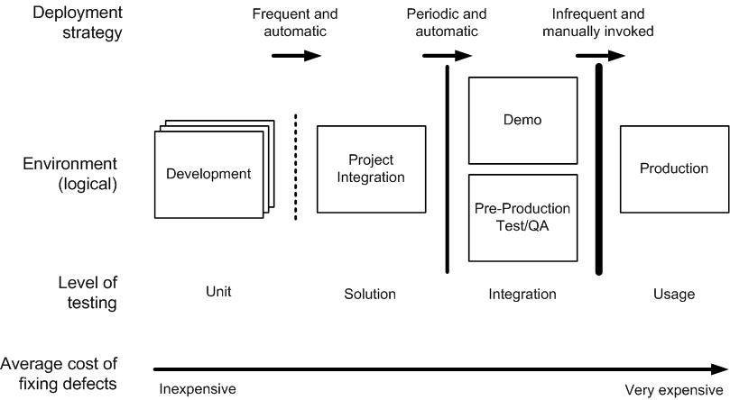
Continuous Deployment (CD)

Slide 58
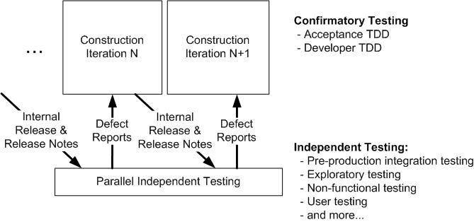
Parallel Independent Testing

Slide 59
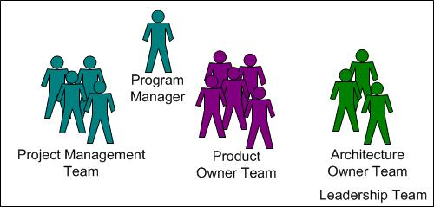
Leadership Teams
For large teams there are several coordination subteams:
Architecture Owners – Responsible for technical coordination
Product Owners – Responsible for requirements coordination
Project Management – Responsible for team coordination and management
How it works:
Early in the project the respective visions are agreed to by key members of each coordination team (plus others)
Throughout the project these teams coordinate their respective issues on a regular basis with one another

Slide 60
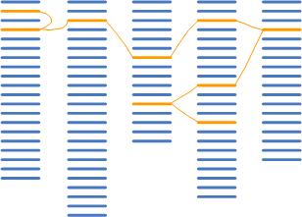
Multiple Backlogs
There are dependencies between work items (including requirements)
When large teams are separated into subteams, and if each subteam has its own work items, then these dependencies need to be managed
Product Owners are responsible for the work items, therefore they need to coordinate dependencies with one another

Slide 61
Exercise: Process Tailoring #1
Get back into your smaller teams
Goal: Develop a process strategy for a new project team
Instructions:
Take 10 minutes to identify how you would approach Inception, Construction, and Transition for the given project scenario
Scenario:
Your organization is new to agile but has recently hired 3 disciplined agile coaches and invested in some disciplined agile training
People within your organization are fairly specialized in traditional roles such as business analysis, programmer, tester, and so on
Your business stakeholders insist on being presented with a description of what you will develop, a +/- 10% cost estimate, and a month-based delivery date (e.g. June 2013) before they will fund development
Your first project will have eight developers co-located in a single room
Your stakeholders are in different buildings in the same city as your developers
Your operations team only has experience with traditional release processes
A spokesperson will describe your approach with the larger group

Slide 62
Exercise: Process Tailoring #2
Get back into your smaller teams
Goal: Develop a process strategy for a new project team
Instructions: Take 10 minutes to work through the given project scenario
Scenario:
Your organization has recently merged with an equal sized competitor in another country. Each organization has an IT group with about 20 developers. There are an additional 5 people who work from home around the globe.
Both organizations are very experienced with small team, co-located agile development
Your organization has also recently contracted with an Indian outsourcing firm to take over system integration, security, and performance testing
International legislation requires IT development teams to document their work and provide full traceability throughout the lifecycle
Your project will be to integrate the systems of your two organizations. There is some overlap between systems, each organization has some unique systems, and there are significant differences in source data. The systems range in age from 2 years to 30 years old, running on different platforms. Some systems have full regression test suites, some have partial suites, and some have manual test cases.
This project is the largest one your organization has ever taken on, with an estimated 30 people required for the team
A spokesperson will share a few key learnings with the larger group

Slide 63
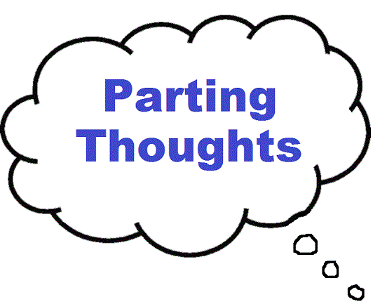


Slide 64
Disciplined Agile Delivery: The Foundation for Scaling Agile
Organizational
Distribution
Team Culture
Organizational
Culture
Domain Complexity
Geographic
Distribution
Team Size
Compliance
Technical
Complexity
Agile Practices
“Traditional”
And more…
Unified Process
Agile Modeling
Scrum
Kanban
Lean
Disciplined Agile Delivery (DAD)
DAD leverages proven strategies from several sources,
providing a decision framework to guide your adoption and
tailoring of them in a context-driven manner.

Slide 65
Agile Experiences with Organizational Complexity
Question: What challenges have (un)successful teams have experienced while adopting agile approaches? (Please check all that apply)
Source: 2012 Agile Scaling Survey
www.ambysoft.com/surveys/

Slide 66
Exercise: What Have You Learned?
Individually, on a sheet of paper, answer the following questions:
What three new things have you learned about agile delivery in general?
What three new things have you learned about scaling agile approaches?
What improvements in the way you approach agile project will you try to adopt when you’re back at work?
What still puzzles you?

Slide 67

A Disciplined Ending….
Please…
Take the opportunity to thank your teammates – we all learned together
Fill out the workshop evaluation form(s)
Turn in the evaluation(s) to the instructor

Slide 68
Thank You!
scott [at] scottambler.com
@scottwambler
Disciplined Agile Delivery
AgileModeling.com
AgileData.org
Ambysoft.com
DisciplinedAgileDelivery.com
EnterpriseUnifiedProcess.com
ScottAmbler.com

Slide 69
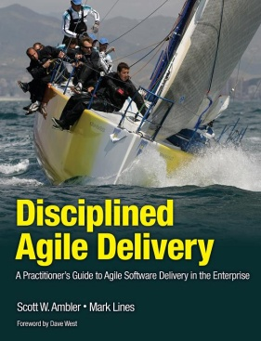
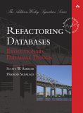


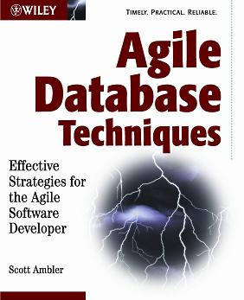


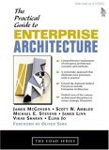





Recommended Resources

